Slide 1
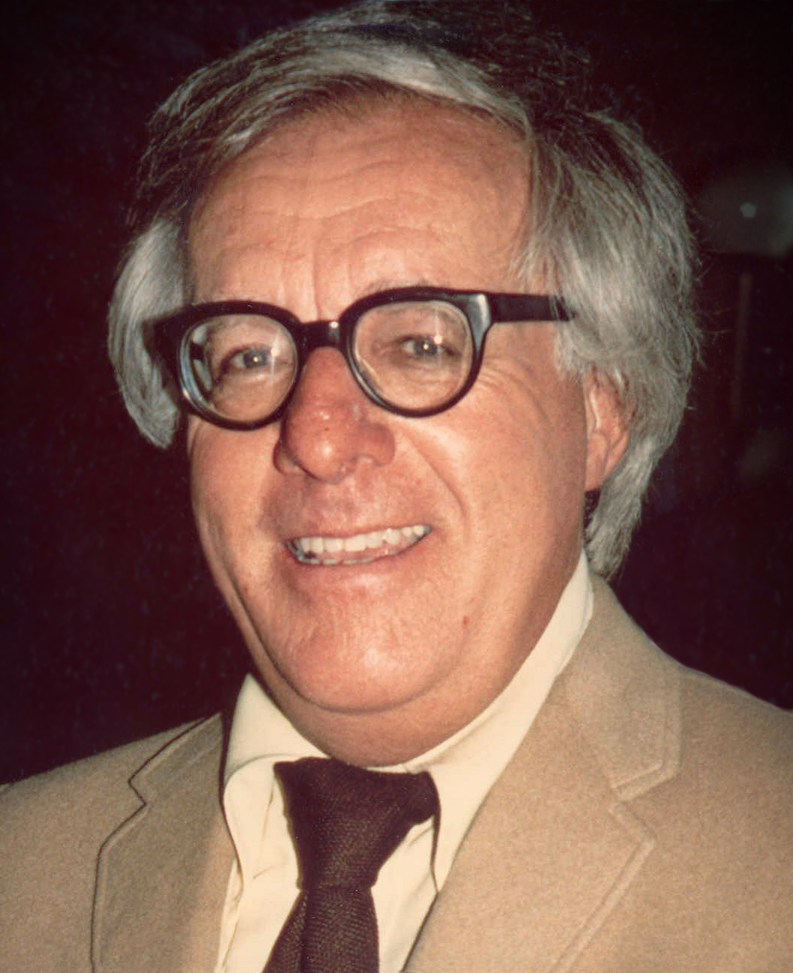
Fahrenheit 451 By: Ray Bradbury
Presentation By: Abigail Gray
Period 2

Slide 2
Summary-
Guy Montag is a fireman in the future where books are illegal. Due the fact that the books are illegal, Guy's job is to burn books in the buildings in which they are kept. He never questions his job until he meets a 17 year old girl named Clarisse. She tells him about a past where firemen put out fires rather than starting them. This causes him to become curious and question his morals.

Slide 3
Plot-
He gets caught with books in his house.
He begins to question his morals.
He is forced to burn down his house.
Clarisse tells him about firefighters past lives.
He becomes a fugitive and is on the run.
He meets other fugitives of which are on the run. The police kill someone who looks like Montag.
Guy meets his new neighbor Clarisse on the way home from work

Slide 4
Setting & Tone-
The setting of this book was in a future city where books were illegal.
The author never directly states the city's name or the year in which this takes place
The tone of this book is kind of dull and almost seems as if the author doesn’t tend to care about this specific topic.

Slide 5
Main Character-
Guy Montag-a fireman who throughout the book mostly believes what he hears from others
Clarisse-Guy's 17 year old neighbor
Mildred-Guy's wife who is addicted to tv
Beatty- the fire chief
Faber-a former English professor

Slide 6
Conflict-
The conflict in Fahrenheit 451 is that Guy wants to learn about the past but the government restricts him from getting more information. On page 5, while talking to Clarisse, Guy states that it is against the law to burn books after being asked if he has ever read the books. He is also rejected by his wife and other people in the environment around him.

Slide 7
Theme #1-
Meeting new people can give you new perspectives on things. On pages 4-6, Clarisse informs Guy of a past time where firemen put out fires rather than starting them. This ends up changing his perspective on his job and other firemen.

Slide 8
Theme #2-
Its okay to question yourself. On page 49, Guy began to question himself and other things that his wife, Mildred was saying. This led him to a fight with his wife, which led up to their divorce.

Slide 9
Theme #3-
Doing the normal thing isn't always the right thing to do. Throughout the book, Guy begins to rebel against the government and Guy ended up realizing that what Clarisse and himself were doing the right thing. This led him to becoming a fugitive but he still believed it was the right thing to do.

Slide 10
Comparison-
One comparison between Guy and Margot from "All Summer in a Day" is that their actions are both based off of the past. In "Fahrenheit 451", Guy's actions are based around what Clarisse tells him about the past, while in "All Summer in a Day", Margot acts based off of what she remembers from Earth. Another comparison from this book is that they end up doing what society doesn’t expect them to do. Towards the middle of "Fahrenheit 451", Guy ends up reading books, which is against his rules. Margot in "All Summer in a Day" does the opposite of her classmates expectations.

Slide 11
Signpost-
"We cannot tell the precise moment when friendship is formed. As in filling a vessel drop by drop, there is at last a drop which makes it run over; so in a series of kindnesses there is at least one which makes the heart run over."
This life lesson is about how it only takes a moment for a stranger to become a friend. This could change his point of view when meeting new people.

